Slide 1

SDET Course
Design Patterns - Mediator

Slide 2
3 Types of Design Patterns
Creational
Singleton
Builder
Prototype
Factory Method
Abstract Factory
Structural
Adapter
Composite
Proxy
Flyweight
Bridge
Facade
Decorator
Behavioral
Strategy
Observer
Command
Memento
State
Template Method
Mediator
Chain of Responsibility
Interpreter
Visitor
Iterator

Slide 3
Agenda
Description
Diagram
Code sample (Java)
Use cases

Slide 4

Description
Introduction - Let’s Make a Team

Slide 5
Description
The Mediator Design Pattern is a behavioral design pattern that promotes the reduction of direct communication between objects to decrease their interdependencies. Instead, objects interact with each other through a mediator object. This mediator centralizes complex communications and control logic between objects in a system, making it easier to understand, maintain, and modify. By decoupling objects from each other, the Mediator pattern allows for more reusable and modular components. This pattern is especially useful in scenarios where an application involves a complex set of interactions between different components, such as in user interface design or when coordinating actions among various system components. The goal of the Mediator pattern is to simplify system design by centralizing interaction in a way that reduces the direct linking of objects, thereby lowering the system's overall complexity.

Slide 6
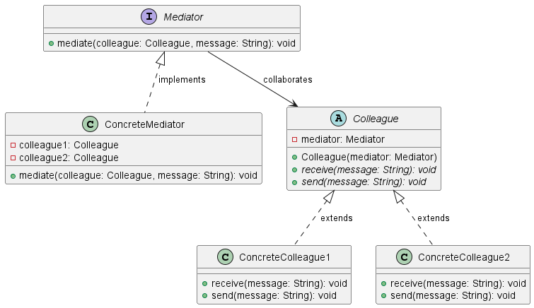
Class Diagram

Slide 7
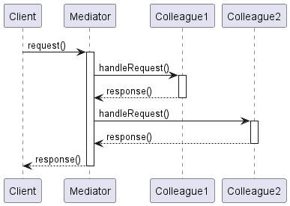
Sequence Diagram

Slide 8
Code Sample

Slide 9
Use cases
General
Chat Applications
Event Management Systems
Smart Home Systems
Financial Trading Platforms
In Test Automation
Test Suite Management
Test Data Preparation
Environment Configuration and Cleanup

Slide 10
Happy Coding

